Slide 1
Deep Learning Artificial Neural Networks
By Daniel Oliveira

Slide 2
Exercise 1. Predicting with a perceptron
We have the following dataset.
x1 | x2
0.5 | 1.5
1.0 | 0.5
1.5 | 2.0
2.0 | 1.0
y
0
0
1
1
X =
Y =

Slide 3
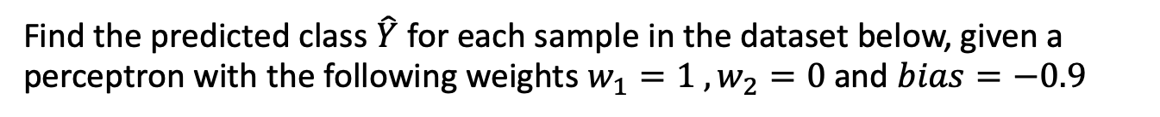
Exercise 1. Predicting with a perceptron
We have the following dataset.
x1 | x2
0.5 | 1.5
1.0 | 0.5
1.5 | 2.0
2.0 | 1.0
y
0
0
1
1
X =
Y =
Find the predicted class $\hat{Y}$ for each sample in the dataset below, given a perceptron with the following weights $w_{1}=1 , w_{2}=0$ and $bias=−0.9$

Slide 4
PAUSE THE VIDEO AND SOLVE THE EXERCISE

Slide 5
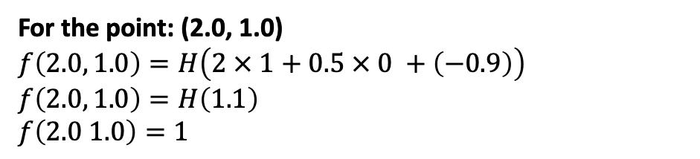
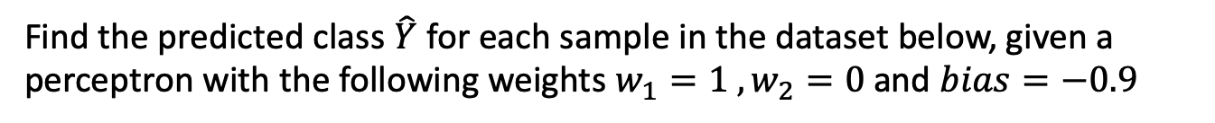
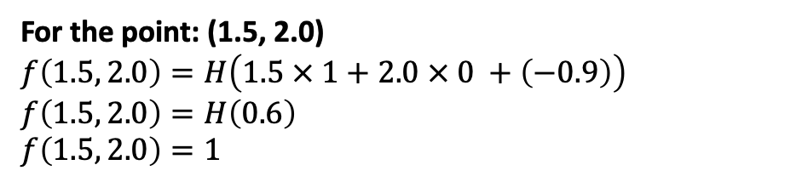
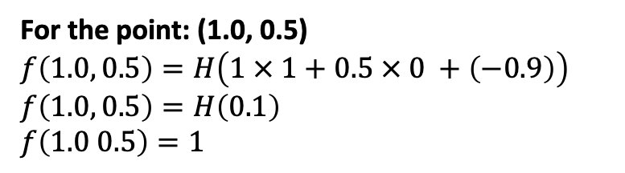
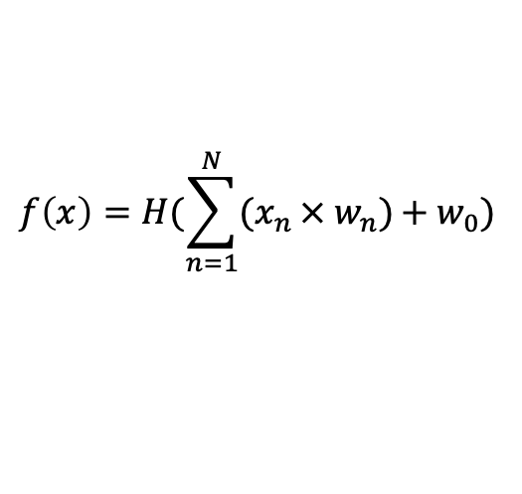
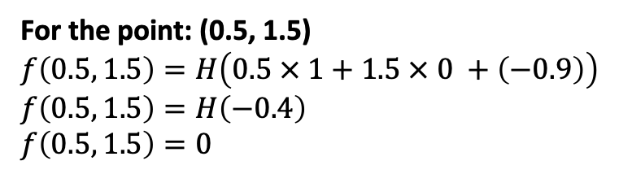
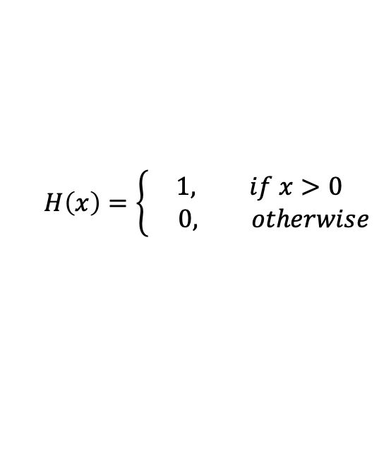
Exercise 1. Predicting with a perceptron
x1 | x2
0.5 | 1.5
1.0 | 0.5
1.5 | 2.0
2.0 | 1.0
Find the predicted class $\hat{Y}$ for each sample in the dataset below, given a perceptron with the following weights $w_{1}=1 , w_{2}=0$ and $bias=−0.9$
X =
$$f\left(x\right)=H(\sum_{n=1}^{N}{{(x}_{n }× w_{n})}+{ w}_{0})$$
$$H\left(x\right)=\left\{\begin{aligned}1, if x>0 \\ 0, otherwise\end{aligned}\right.$$
For the point: (0.5, 1.5)
$$f\left(0.5, 1.5\right)=H\left(0.5 × 1+1.5 × 0 +\left(−0.9\right)\right)$$
$$f\left(0.5, 1.5\right)=H\left(−0.4\right)$$
$$f\left(0.5, 1.5\right)=0$$
For the point: (1.5, 2.0)
$$f\left(1.5, 2.0\right)=H\left(1.5 × 1+2.0 × 0 +\left(−0.9\right)\right)$$
$$f\left(1.5, 2.0\right)=H\left(0.6\right)$$
$$f\left(1.5, 2.0\right)=1$$
For the point: (1.0, 0.5)
$$f\left(1.0, 0.5\right)=H\left(1 × 1+0.5 × 0 +\left(−0.9\right)\right)$$
$$f\left(1.0, 0.5\right)=H\left(0.1\right)$$
$$f\left(1.0 0.5\right)=1$$
For the point: (2.0, 1.0)
$$f\left(2.0, 1.0\right)=H\left(2 × 1+0.5 × 0 +\left(−0.9\right)\right)$$
$$f\left(2.0, 1.0\right)=H\left(1.1\right)$$
$$f\left(2.0 1.0\right)=1$$

Slide 6
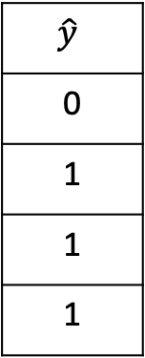

Exercise 1. Predicting with a perceptron
Find the predicted class $\hat{Y}$ for each sample in the dataset below, given a perceptron with the following weights $w_{1}=1 , w_{2}=0$ and $bias=−0.9$
Our final $\hat{Y}$is:
x1 | x2
0.5 | 1.5
1.0 | 0.5
1.5 | 2.0
2.0 | 1.0
y
0
0
1
1
$$\hat{y}$$
0
1
1
1
X =
Y =
$\hat{Y}$ =

Slide 7
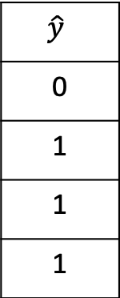

Exercise 2. Training a perceptron
Train the perceptron from exercise 1 for a full epoch with the learning rate $η=0.2$ . Did it converge to a correct solution? Why?
Remember that:
$$\hat{y}$$
0
1
1
1
$\hat{Y}$ =

Slide 8
PAUSE THE VIDEO AND SOLVE THE EXERCISE

Slide 9

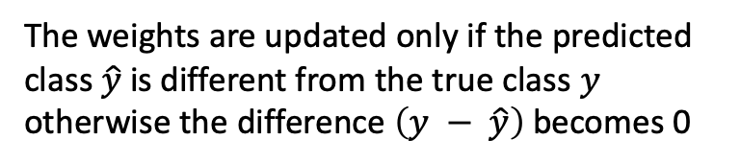
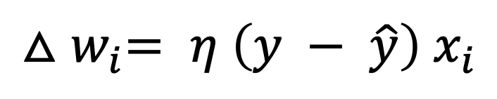
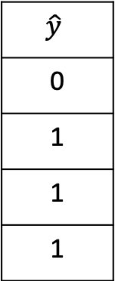
Exercise 2. Training a perceptron
x1 | x2
0.5 | 1.5
1.0 | 0.5
1.5 | 2.0
2.0 | 1.0
y
0
0
1
1
$$\hat{y}$$
0
1
1
1
X =
Y =
$\hat{Y}$ =
$${△w}_{i}= η \left(y − \hat{y}\right) x_{i}$$
The weights are updated only if the predicted class $\hat{y}$ is different from the true class $y$ otherwise the difference $\left(y − \hat{y}\right)$ becomes 0

Slide 10

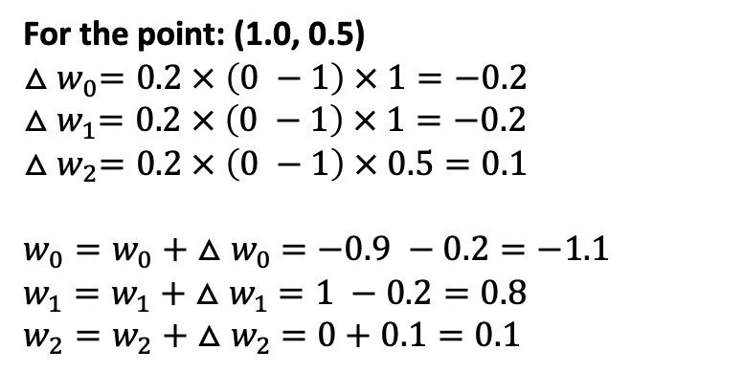
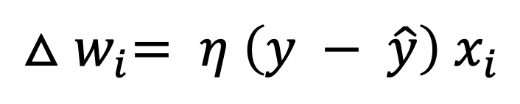
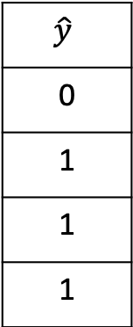
Exercise 2. Training a perceptron
$${△w}_{i}= η \left(y − \hat{y}\right) x_{i}$$
For the point: (1.0, 0.5)
$${△w}_{0}=0.2 × \left(0 −1\right) × 1=−0.2$$
$${△w}_{1}=0.2 × \left(0 −1\right) × 1=−0.2$$
$${△w}_{2}=0.2 × \left(0 −1\right) × 0.5=0.1$$
$w_{0}=w_{0}+ {△w}_{0} =−0.9 −0.2=−1.1$
$w_{1}=w_{1}+ {△w}_{1} =1 −0.2=0.8$
$w_{2}=w_{2}+ {△w}_{2} =0+0.1=0.1$
x1 | x2
0.5 | 1.5
1.0 | 0.5
1.5 | 2.0
2.0 | 1.0
y
0
0
1
1
$$\hat{y}$$
0
1
1
1
-0.9
1.0
0.0
W =
X =
Y =
$\hat{Y}$ =
All points are now correctly classified (check by yourself using the steps from exercise 1).
The perceptron converged to a correct solution because the data is linearly separable.

